Slide 1
Surfing Contest
Australia
Organized by Erensu, Florian, Hanieh and Bartek

Slide 2
Who we are
We are an Australian surf equipment brand looking to organize a surfing competition within our country.
We are currently in the process of choosing a location and timeframe that ensures the safety of participants and facilitates a successful event.

Slide 3
Our hypothesis
During specific months and in certain regions (states), favorable conditions contribute to a lower risk of shark attacks, providing a secure and enjoyable surfing experience.
Notes:
A non-fatal shark attack is ok, you can’t escape the destiny.
When “injury” column is empty, we assumed the incident was non-fatal.

Slide 4
Our approach
Clean relevant columns: date, state, country and injury
Removing at the beginning duplicates
State: filled nulls with “mode”
Date: extracted the month only as numiercial (1-12), otherwise dropped
Injury: Creating “Fatal or not” boolean to identify fatal incidences
Country: Filtered out Australia
Notes:
A non-fatal shark attack is ok, you can’t escape the destiny.
When “injury” column is empty, we assumed the incident was non-fatal. After investigating the column, although there are 4k unique entries, we realize that when the injury is Fatal, keyword “Fatal” is mentioned in every instance. (searched for synonyms like: dead, death, killing, kill). Thus we created a “Fatal or not” boolean to identify fatal incidences

Slide 5
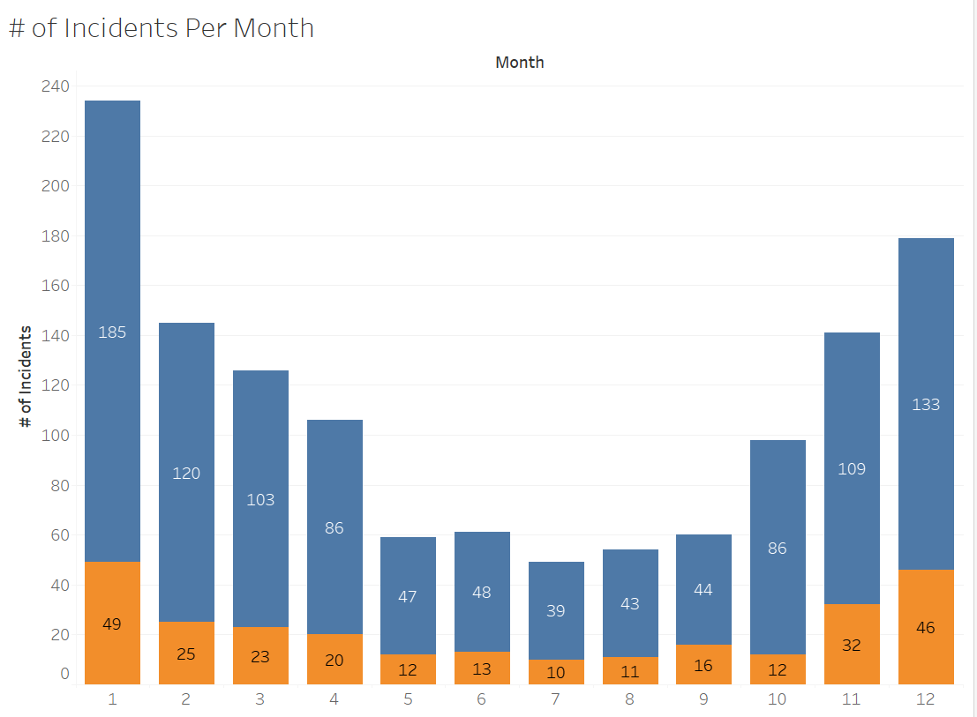
Data: Incidents per month
Non-Fatal
Fatal
🔵
🟠

Slide 6
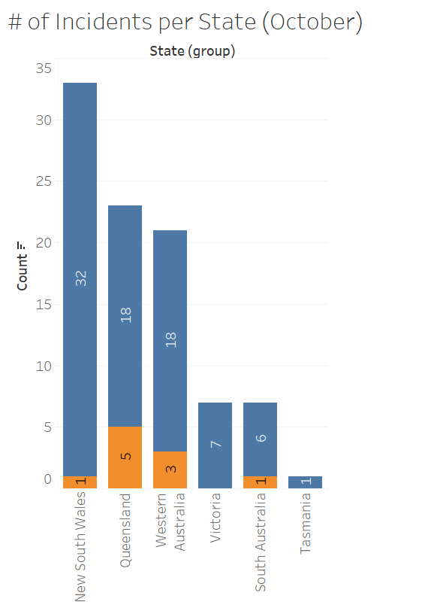
Incidents per state in October
Non-Fatal
Fatal
🔵
🟠

Slide 7
Conclusion
Available data points:
Additional data points needed:
Clear trend based on seasonality. Smallest ratio between fatal and non-fatal indiates Oct.
Based on ratio between fatal/non-fatal and proximity to cities - potential location New South Wales.
To get a more comprehensive picture and support our hypothesis. E.g.:
Surfers/swimmers per month
Inhabitants per state
More granular local data

Slide 8
Project challenges
Coding issues
Defining a clear hypothesis
Collaboration
and split in dev & research

Slide 9
Thank you!
Erensu, Florian, Hanieh and Bartek

